Slide 1

Current Safaricom Financial Performance Analysis (2022-2024)
Presenter: Ibrahim Kibui Kiria

Slide 2

Introduction
As one of Kenya's largest and most influential telecommunications providers, Safaricom has established itself as a leader in the industry, offering a wide range of services, including mobile telephony, data services, and the highly popular M-Pesa mobile money platform.
Over the past few years, the company has demonstrated notable financial progress, driven by its strategic initiatives aimed at expanding service offerings and enhancing customer engagement.
The objective of this analysis is to comprehensively evaluate Safaricom’s financial performance from 2022 to 2024, focusing on key financial metrics that provide insights into its profitability and growth potential.
The primary metrics under review include Total Revenue, which measures the company’s overall income from its diverse service portfolio; Net Income, reflecting profitability after accounting for all expenses; EBITDA Margin, an indicator of core operational efficiency by analyzing earnings before interest, taxes, depreciation, and amortization as a percentage of revenue; and Net Profit Margin, which highlights the proportion of revenue that remains as profit after all costs are deducted.
Additionally, an in-depth analysis of Cash Flow Activities will be conducted to assess the company's ability to generate cash from operations, invest in growth initiatives, and manage its financing needs effectively.
This evaluation aims to provide a comprehensive overview of Safaricom's current valuation, identifying the key drivers of financial performance and offering insights into its potential growth trajectory in a competitive market environment.

Slide 3
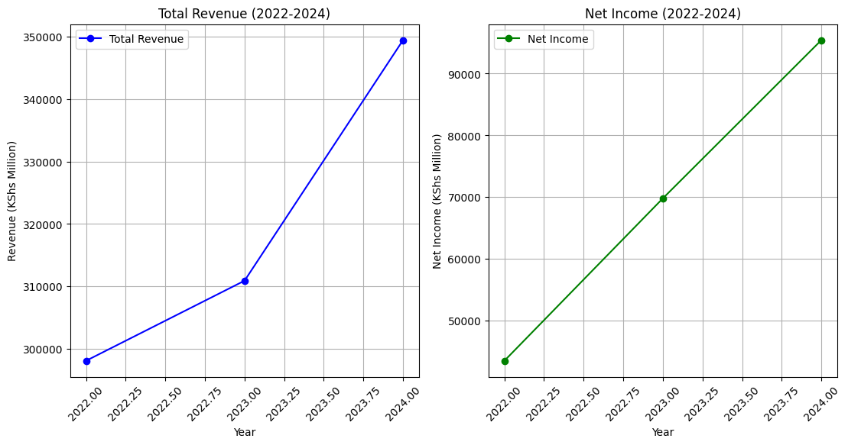

Revenue and Net Income Growth (2022-2024)
From 2022 to 2024, Safaricom demonstrated a strong upward trajectory in both total revenue and net income, reflecting its strategic resilience in a competitive market.
Starting in 2022, the company generated Ksh 298,078 million in total revenue, primarily driven by its core services like mobile telephony, data offerings, and M-Pesa.
In 2023, revenue rose modestly by 4.29% to Ksh 310,905 million, a slower growth rate attributed to market saturation, increased competition, and broader economic pressures impacting consumer spending.
However, 2024 marked a significant recovery with a 12.38% increase in total revenue, reaching Ksh 349,447 million.
This robust growth was fueled by strategic initiatives such as product diversification, expansion in data services, and improved customer engagement efforts, showcasing Safaricom's ability to capitalize on new revenue streams.
Similarly, net income followed a notable growth pattern, rising from Ksh 43,495 million in 2022 to Ksh 69,795 million in 2023, representing a 60.48% increase driven by enhanced operational efficiency and cost management.
By 2024, net income had climbed further to Ksh 95,412 million, underscoring the effectiveness of Safaricom's strategies in optimizing profitability.
The steady rise in both revenue and net income highlights the company’s strong financial performance and its ability to navigate market challenges while enhancing shareholder value.

Slide 4

Analysis of Revenue and Net Income Trends
In examining the trends of Safaricom's revenue and net income from 2022 to 2024, it is evident that the company faced a period of modest growth in 2023, followed by a significant recovery in 2024.
The slow revenue growth of 4.29% in 2023 can be attributed to market saturation and increased competition from other telecom providers, which limited Safaricom’s ability to expand its market share significantly.
However, in 2024, the company experienced a robust 12.38% increase in revenue, driven by strategic initiatives such as product diversification, the expansion of its data services, and enhanced customer retention efforts.
On the net income side, substantial growth was observed, with a 60.48% rise in 2023, mainly due to improved operational efficiency and rigorous cost management.
This focus on optimizing expenses, coupled with strategic efforts to boost revenue, positioned Safaricom well for continued profitability in 2024, underscoring its effective adaptation to market conditions.
The overall trends indicate Safaricom's strong capacity to enhance its financial performance despite external pressures, making it a resilient player in the telecommunications sector.

Slide 5
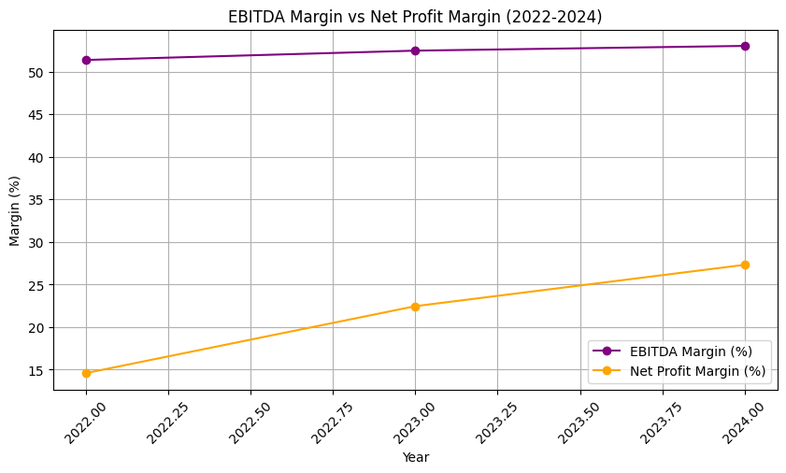
EBITDA Margin Analysis (2022-2024)
Safaricom's EBITDA margin demonstrated a stable upward trend from 2022 to 2024, increasing from 51.36% in 2022 to 53.01% in 2024.
This stability in margins reflects the company's efficient management of its operational costs, even amidst external challenges such as inflationary pressures and heightened competition in the telecommunications market.
The ability to maintain and slightly improve the EBITDA margin indicates that Safaricom effectively controlled its core expenses while sustaining profitability at the operational level.
The consistent EBITDA margin growth suggests a solid foundation in Safaricom's business operations, reinforcing its capacity to generate strong earnings before interest, taxes, depreciation, and amortization, which is a key indicator of the company's core profitability and financial health.

Slide 6
Net Profit Margin Analysis (2022-2024)
Safaricom's net profit margin experienced a significant increase between 2022 and 2024, rising from 14.59% in 2022 to a notable 27.30% in 2024.
This sharp improvement highlights the company's success in enhancing overall profitability through strategic cost management and pricing adjustments.
The increase in net profit margin reflects Safaricom's strengthened pricing power, which allowed it to retain a larger portion of its revenue as profit, despite external economic challenges.
Additionally, optimized tax liabilities and reduced interest expenses contributed to this growth, enabling the company to boost its bottom line effectively.
This substantial rise in net profit margin underscores Safaricom's robust financial strategies, aimed at maximizing shareholder value through improved efficiency and profitability.

Slide 7
Profitability Drivers
The stability observed in Safaricom's EBITDA margin over the period from 2022 to 2024 can be attributed to effective cost control measures, demonstrating the company’s ability to manage its core expenses efficiently.
The notable increase in net profit margin was driven by a combination of strategic pricing adjustments, which enhanced revenue retention, and optimized tax liabilities, which reduced financial burdens.
Additionally, improved operational efficiency played a critical role in boosting overall profitability.
By focusing on these key drivers, Safaricom managed to increase its profitability while maintaining strong operational performance, ultimately solidifying its financial position and enhancing value creation for shareholders.

Slide 8
Cash Flow Analysis Overview (2022-2024)
Safaricom's cash flow activities from 2022 to 2024 reveal a well-balanced approach to managing financial resources.
The company consistently generated strong operating cash flows, primarily from its core services like mobile telephony and the M-Pesa platform, reflecting robust performance in revenue-generating activities.
However, the investing cash flow was consistently negative due to substantial investments in technology upgrades and infrastructure development, highlighting the company’s commitment to long-term growth and service enhancement.
To support these heavy investments, Safaricom resorted to external financing, resulting in negative financing cash flows during this period.
This pattern indicates a strategic focus on reinvesting earnings into the business to drive future growth, balanced by prudent financial management to maintain liquidity and operational stability.

Slide 9
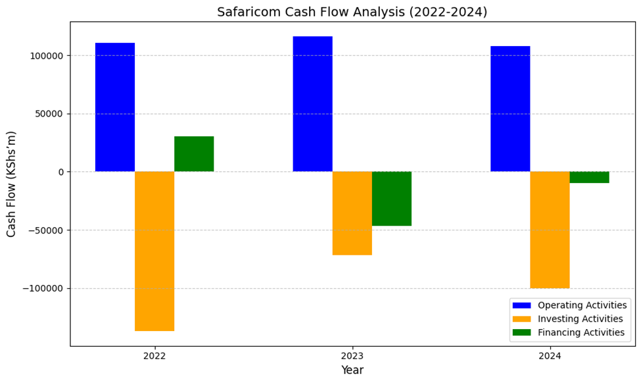
Visual Analysis of Cash Flows
In 2022, Safaricom reported high operating cash flow exceeding 100 billion Kenyan Shillings, indicating strong cash generation from its core business operations.
However, this was offset by substantial investing activities, with negative cash flows of around 120 billion Kenyan Shillings due to heavy capital expenditures.
A similar pattern was observed in 2023 and 2024, with continued strong operating cash flows matched by significant reinvestments in technology and infrastructure.
The reliance on external financing to support these investments resulted in negative financing cash flows over the three-year period.
This consistent trend highlights Safaricom’s strategic approach to balancing growth through reinvestments with the need for financial prudence, aiming to ensure sustainable long-term expansion and profitability.

Slide 10
Conclusion
The financial performance of Safaricom from 2022 to 2024 showcases a steady increase in both revenue and net income, driven by strategic growth initiatives and effective cost management.
The company demonstrated consistent profitability improvements, as reflected in the rising EBITDA and net profit margins, indicating strong operational efficiency and pricing power.
Additionally, the robust cash flow management, with high operating cash flows and strategic reinvestments, underscores Safaricom’s focus on long-term growth and financial stability.
Overall, the positive trajectory in key financial metrics points to Safaricom’s ability to maintain its market dominance and deliver sustained value to shareholders, positioning it well for future growth in the competitive telecommunications sector.

Slide 11

Strategic Outlook
Looking ahead, Safaricom aims to solidify its market position by expanding its service offerings, particularly in high-growth areas such as M-Pesa and data services.
The company plans to continue investing in cutting-edge technology and infrastructure to enhance service quality and customer experience.
Additionally, Safaricom's focus on innovation and customer engagement is expected to drive further revenue growth and profitability.
By prioritizing these strategic initiatives, Safaricom anticipates a positive growth trajectory and sustained value creation for its shareholders, ensuring it remains a leader in the telecommunications industry in Kenya and beyond.

Slide 12

THANK YOU

